Slide 1

Master Program in Data Science and Advanced Analytics 2018/19 Introduction to Programming
Spatio-Temporal Analysis of Crime Rates and Housing Prices in London
Adeoluwa Akande – d20170353
Carolina Araújo – m20180262
Julian Kuypers – m20180409
Francisco Freitas – m20170062

Slide 2

Summary
Introduction
The Data
The Dataset
Crime Analysis
Housing Prices Analysis
Spatial Analysis
Prediction Models
Conclusions

Slide 3
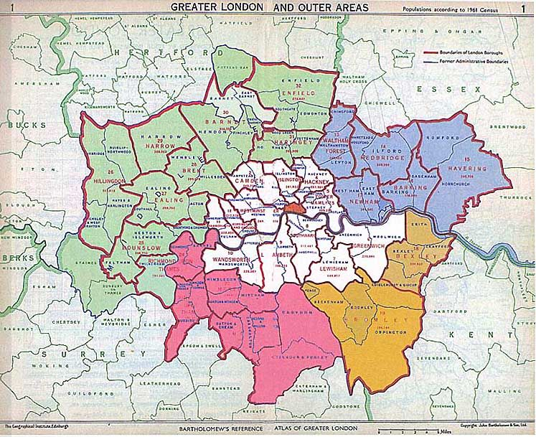
Introduction
Surge in crime rates since 2016
Analysis of street level crime
Study correlation between crime rates and housing price
Crime prediction exploration

Slide 4
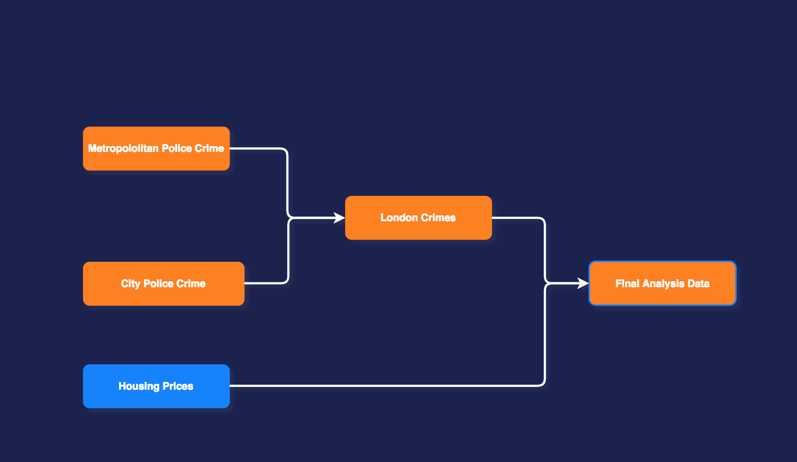
The Data

Slide 5
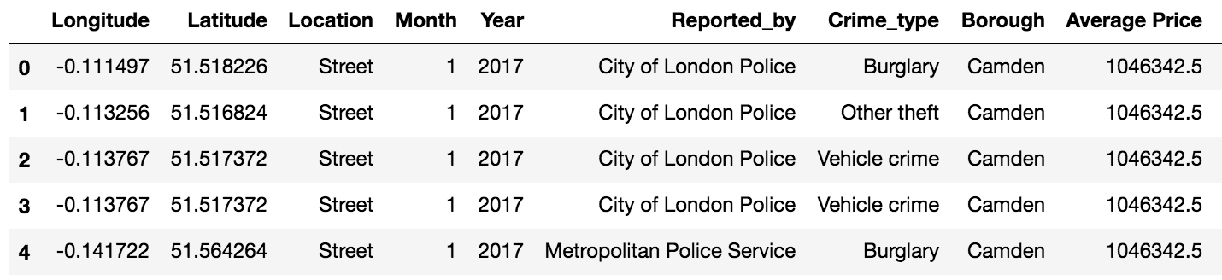
The Dataset
Crime ID (str)
Month (Datetime)
Reported by (str)
Falls Within (str)
Longitude (float)
Latitude (float)
Location (str)
LSOA Code (str)
LSOA Name (str)
Crime Type (str)
Context (str)
Last Outcome Category
Borough Average Housing Price (float)

Slide 6
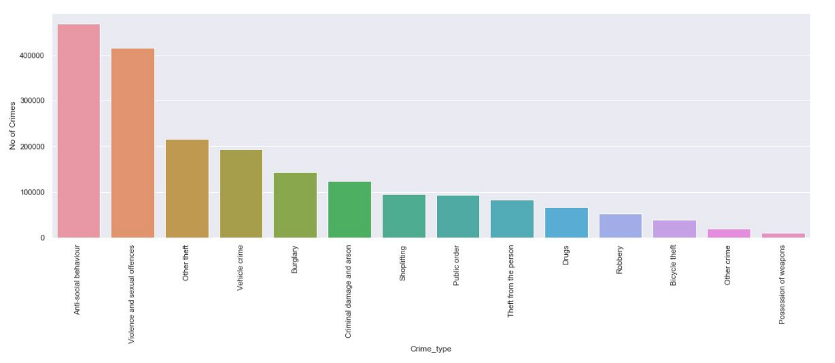
Crime Analysis – Most Common Crimes
Top 5 Crimes:
Anti Social Behaviour
Violence and Sexual Offenses
Vehicle Crimes
Burglary
Criminal Damage and Arson

Slide 7
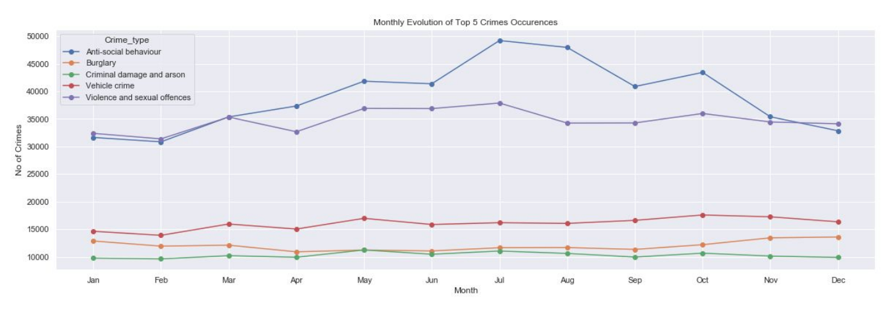
Crime Analysis – Seasonality of Crime
Higher Anti-Social Behaviour during summer months
Other crimes do not follow a particular seasonal patterns

Slide 8
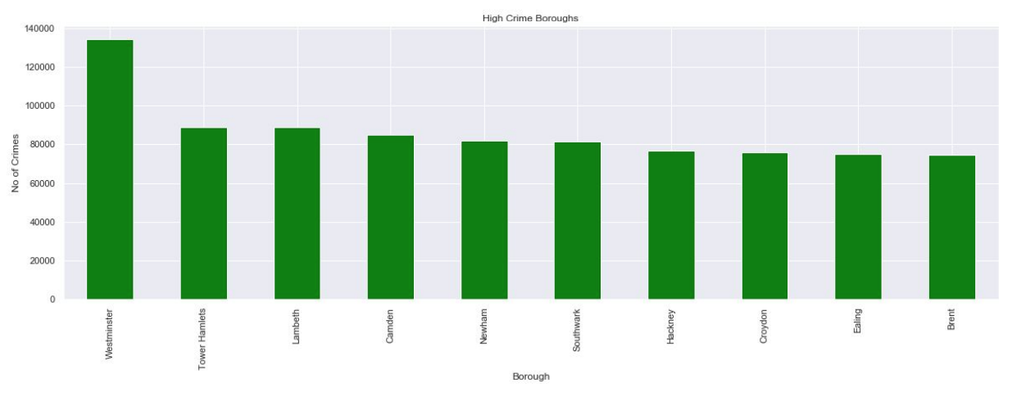
Crime Analysis – High Crime-Rate Boroughs
Top 5 Crime Boroughs:
Westminster
Tower Hamlets
Lambeth
Camden
Newham

Slide 9
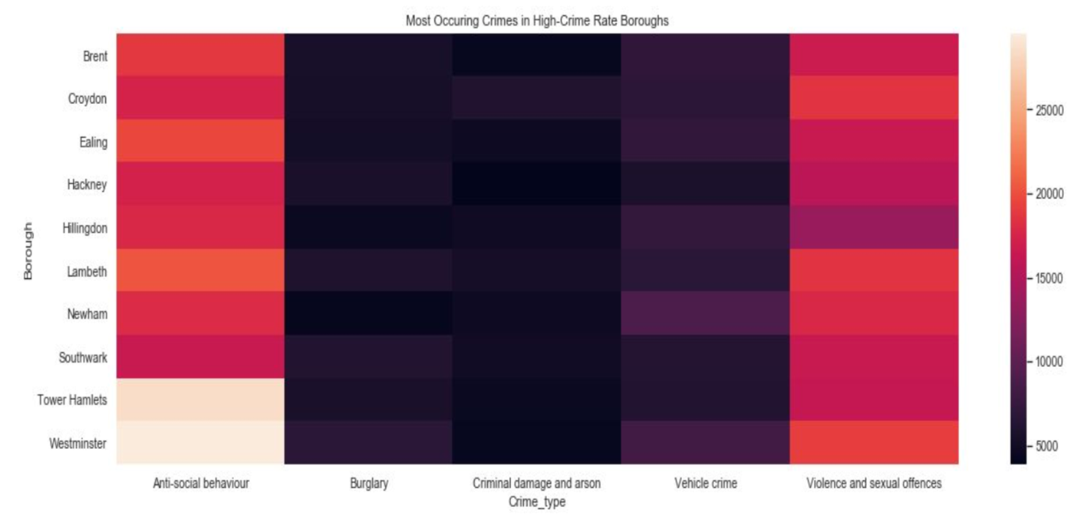
Crime Analysis – Types of Crime per Borough

Slide 10
Monthly Trend in Reported Crimes
Higher peaks during summer months and beginning of the new year

Slide 11
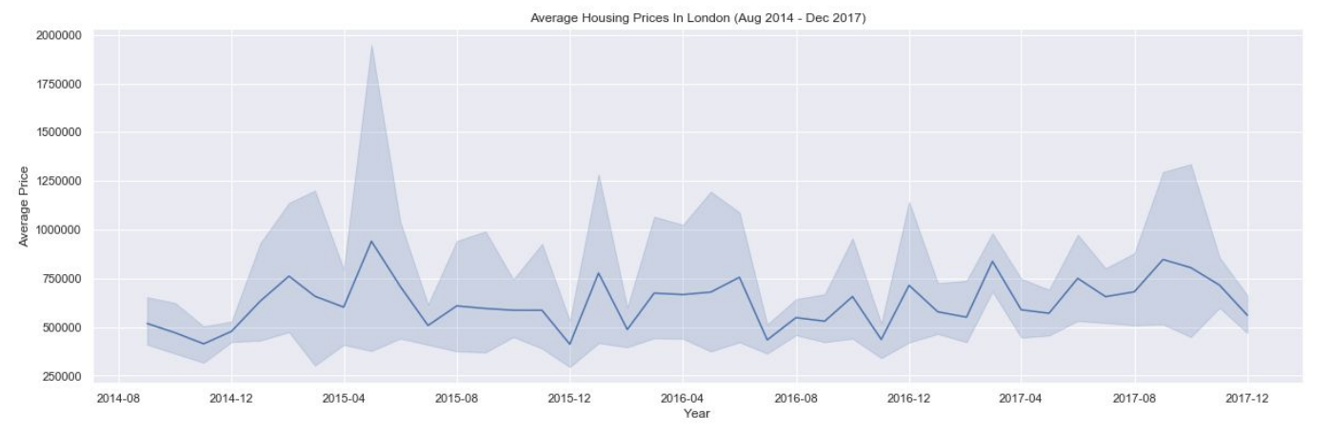
Housing Analysis – Seasonality of Housing Prices
Higher peaks during summer months and beginning of the new year

Slide 12
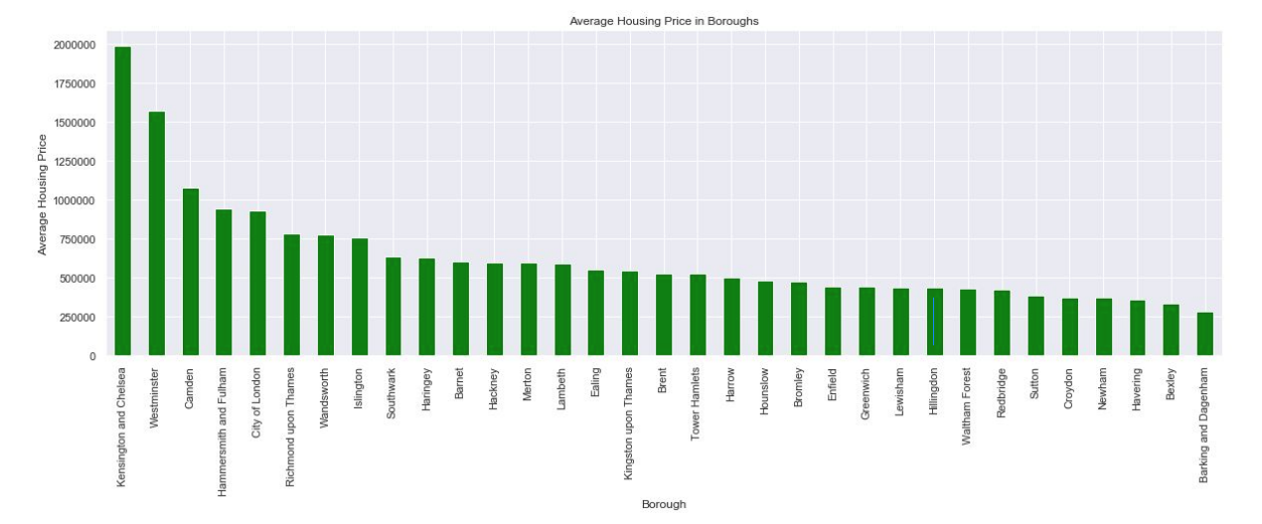
Housing Analysis – Most Expensive Boroughs
Most Expensive Boroughs:
Kensington & Chelsea
Westminster
Camden
Hammersmith & Fulham
City of London

Slide 13
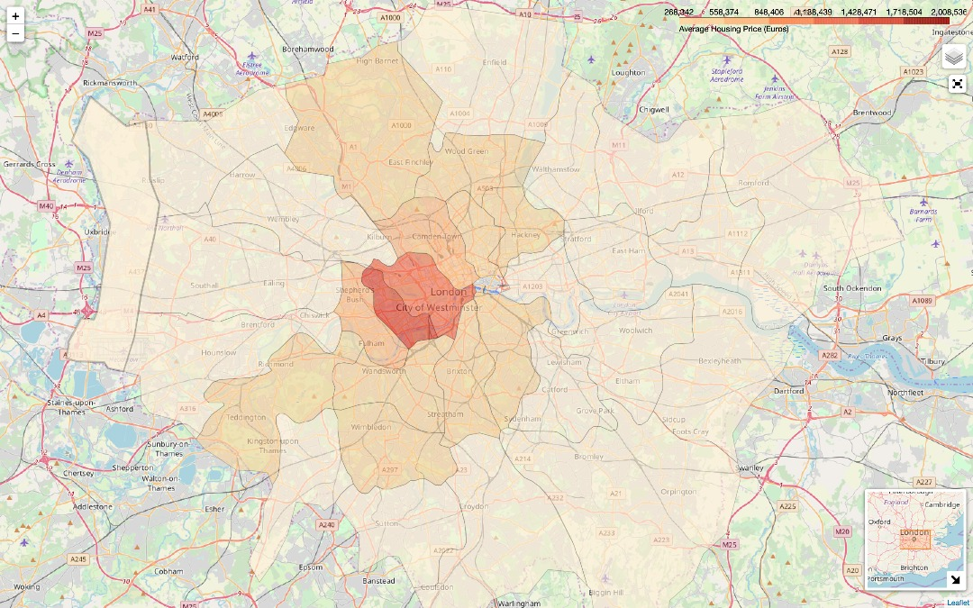
Spatial Analysis – Housing Prices

Slide 14
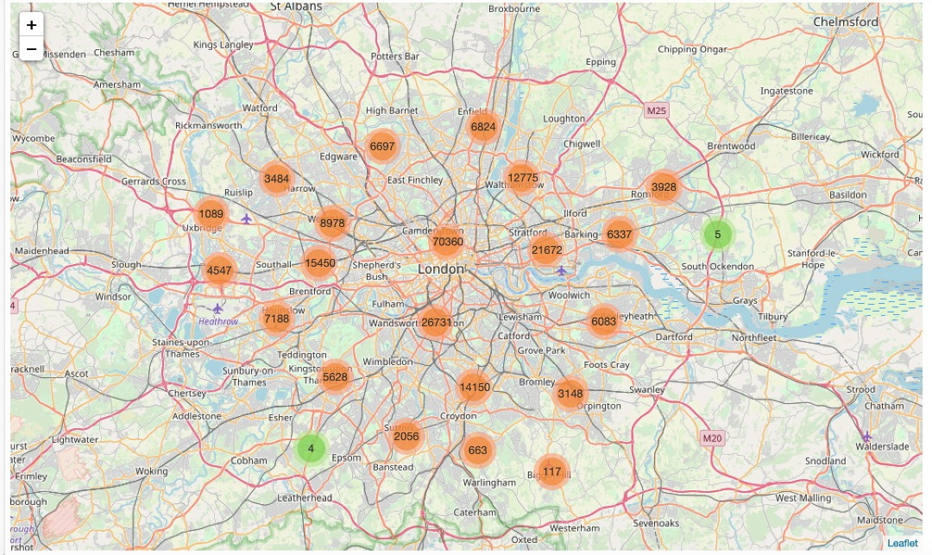
Spatial Analysis – Crime

Slide 15
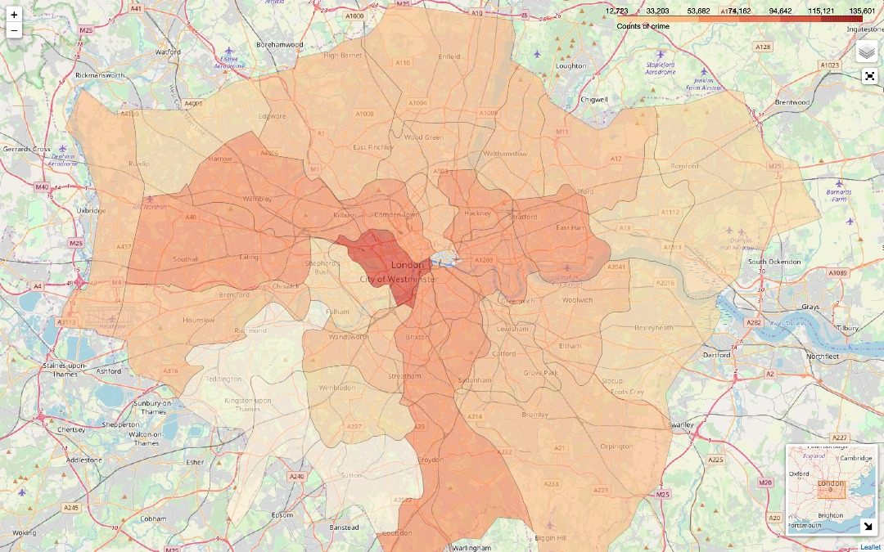
Spatial Analysis – Crime

Slide 16
Prediction Models for Classification
 | LogLoss | LogLoss (no housing price)
Random Forest Classifier | 1.44 | 1.44
Gradient Boosting Tree Classifier | 1.45 | 1.46
K-Nearest Neighbor | 1.47 | 1.46
Logistic Regression | 1.45 | 1.45

Slide 17
Conclusion
Confirmed correlation between housing price and crime rates
Discovered relation between high tourists spots and high crime spots
Could extend our study by comparing poverty rates instead of housing prices

Slide 18

Q&A

Slide 19
References
R. Story, Folium: Make Beautiful Maps with Leaflet.Js & Python (2015). 2
R. Story, (2013).
R. Schutt and C. O’Neil, Doing Data Science: Straight Talk from the Frontline (O’Reilly Media, Sebastopol, 2014).
F. Pedregosa, G. Varoquaux, A. Gramfort, V. Michel, B. Thirion, O. Grisel, M. Blondel, P. Prettenhofer, R. Weiss, V. Dubourg, J. Vanderplas, A. Passos, D. Cournapeau, M. Brucher, M. Perrot, and E. Duchesnay, J. Mach. Learn. Res. 12, 2825 (2011).

